Slide 1
Lexical Analysis

Slide 2
Contents
The role of the lexical analyzer
Specification of tokens
Finite state machines
From a regular expressions to an NFA
Convert NFA to DFA
Transforming grammars and regular expressions
Transforming automata to grammars
Language for specifying lexical analyzers

Slide 3
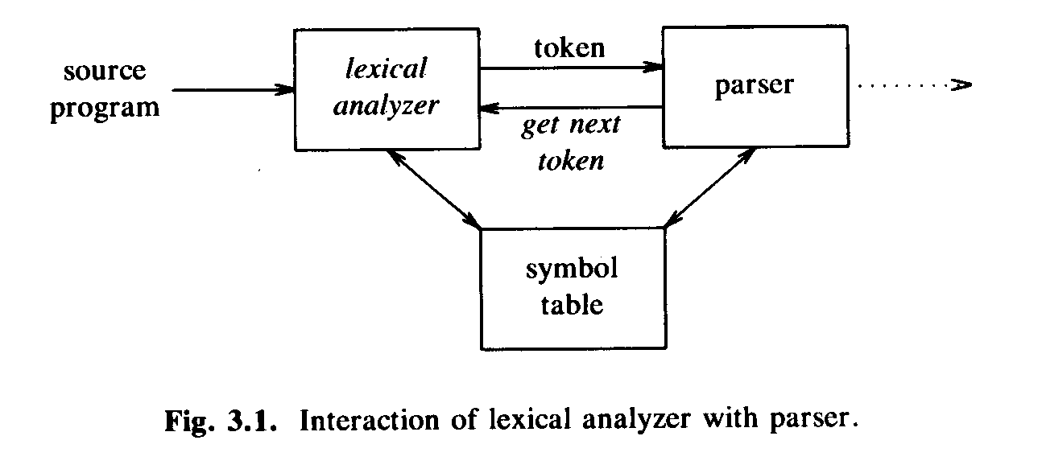
The Role of Lexical Analyzer
Lexical analyzer is the first phase of a compiler.
Its main task is to read input characters and produce as output a sequence of tokens that parser uses for syntax analysis.

Slide 4
LA could be a separate pass – need intermediate file.
LA and SA are together in the same pass – eliminate the need of intermediate file.
LA returns to the parser a representation for the token it has found.

Slide 5
The representation is
An integer code
If the token is a simple construct.
Ex: paranthesis, comma
A pair
Integer code and a pointer to the value of that token
Ex: identifiers, constant.
Integer code – token type
Pointer – value of that token
Pairs are used when the instances of a token need to be distinguished. (Operators: +, * , < , <= )

Slide 6
Overview of Scanning
The function of a scanner (called also lexical analyzer) is to:
Read characters from the source file
Group input characters into meaningful units, called tokens
The scanner takes care of other things as well:
Removal of comments and white space
Keeping track of current line number
Required for reporting error messages

Slide 7
Case conversions of identifiers and keywords
Simplifies searching if the language is not case-sensitive
Interpretation of compiler directives
Flags are internally set to direct code generation
Communication with the symbol or literal table
Identifiers can be entered in the symbol table
String literals can be entered in the literal table

Slide 8
Issues in Lexical Analysis
There are several reasons for separating the analysis phase of compiling into lexical analysis and parsing:
Simpler design
Compiler efficiency
Compiler portability
Specialized tools have been designed to help automate the construction of lexical analyzer and parser when they are separated.

Slide 9
Simplicity of design
Separation of lexical from syntactical analysis ->simplify at least one of the tasks
e.g. parser dealing with white spaces -> complex
Cleaner overall language design
Improved compiler efficiency
Liberty to apply specialized techniques that serves only lexical tasks, not the whole parsing
Speedup reading input characters using specialized buffering techniques
Enhanced compiler portability
Input device peculiarities are restricted to the lexical analyzer

Slide 10
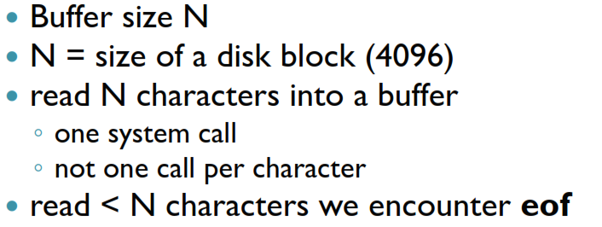
Input Buffering

Slide 11
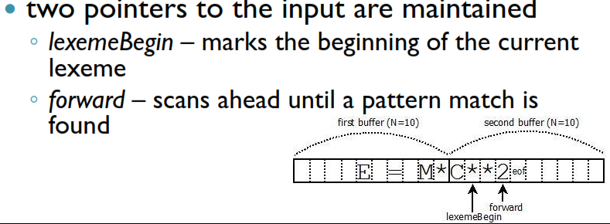

Slide 12

Sentinels
forward pointer
◦ to test if it is at the end of the buffer
◦ to determine what character is read (multiway branch)
 sentinel
◦ added at each buffer end
◦ can not be part of the source program
◦ character eof is a natural choice
retains the role of entire input end
when appears other than at the end of a buffer it means that the input is at an end

Slide 13
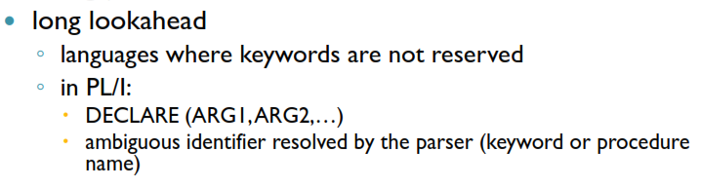

Slide 14
Tokens, Patterns, Lexemes
A lexeme is a sequence of characters in the source program that is matched by the pattern for a token.
A lexeme is a basic lexical unit of a language comprising one or several words, the elements of which do not separately convey the meaning of the whole.

Slide 15
Tokens, Patterns, Lexemes
The lexemes of a programming language include its identifier, literals, operators, and special words.
A token of a language is a category of its lexemes.
A pattern is a rule describing the set of lexemes that can represent as particular token in source program.

Slide 16
Example: System.out.println(“Hello Class”);
has tokens System, dot, out, dot, println, left paren, String Hello Class, right paren and a semicolon.

Slide 17
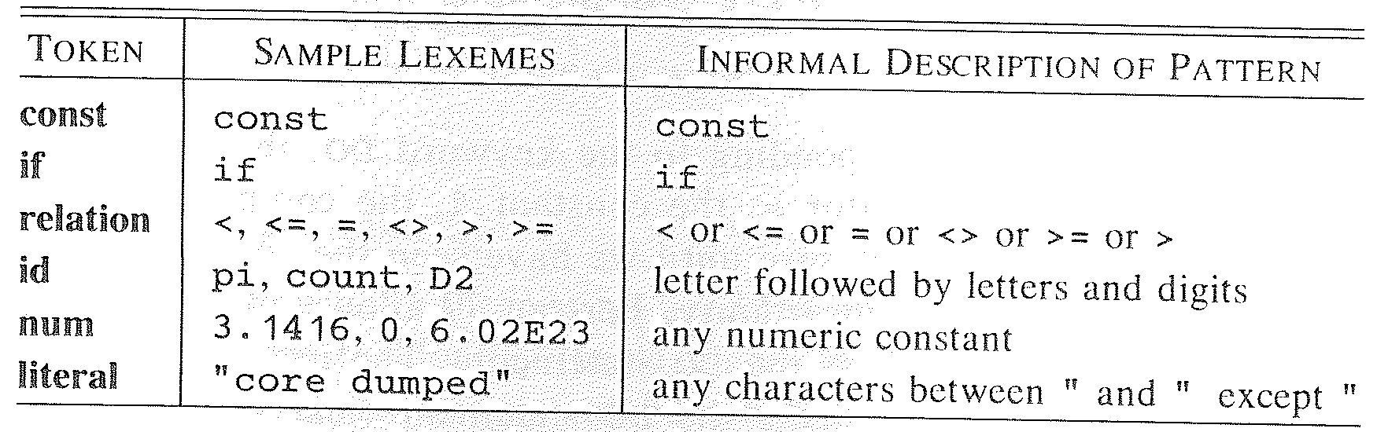
Examples of Tokens
const pi = 3.1416;
The substring pi is a lexeme for the token “identifier.”

Slide 18
Lexeme and Token
Index = 2 * count +17;
Lexemes
Tokens
Index
Identifier
=
equal_sign
2
int_literal
*
multi_op
Count
identifier
+
plus_op
17
int_literal
;
semicolon

